Slide 1
Chapter 15: System Configuration and Protection
The PIC18 Microcontroller
Han-Way Huang
Minnesota State University, Mankato
June 2004

Slide 2
Configuration Registers
Many of the settings and modes of the PIC18 devices are controlled by a group of configuration registers.
The configuration registers are located at from 0x300001 to 0x30000D.
The device IDs are stored at 0x3FFFFE-0x3FFFFF.
These addresses are beyond the user program memory space and can only be accessed using the table-read and table-write instructions.
Programming the configuration registers is done in a manner similar to programming the flash memory.
Setting the WR bit of the EECON1 register starts a self-timed write operation to the specified configuration register.

Slide 3
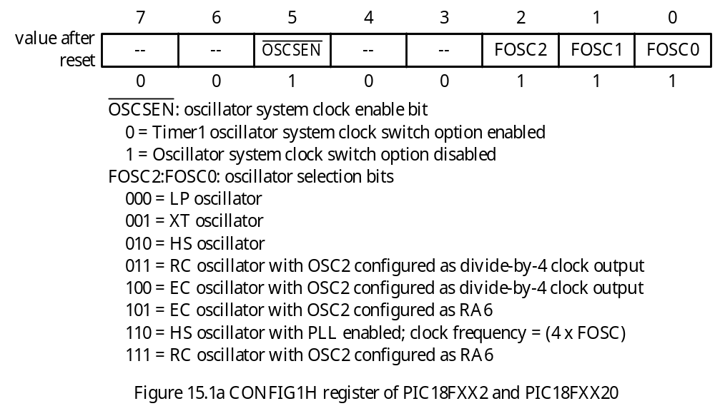
The CONFIG1H Register
- Users select the type of oscillator via this register.

Slide 4
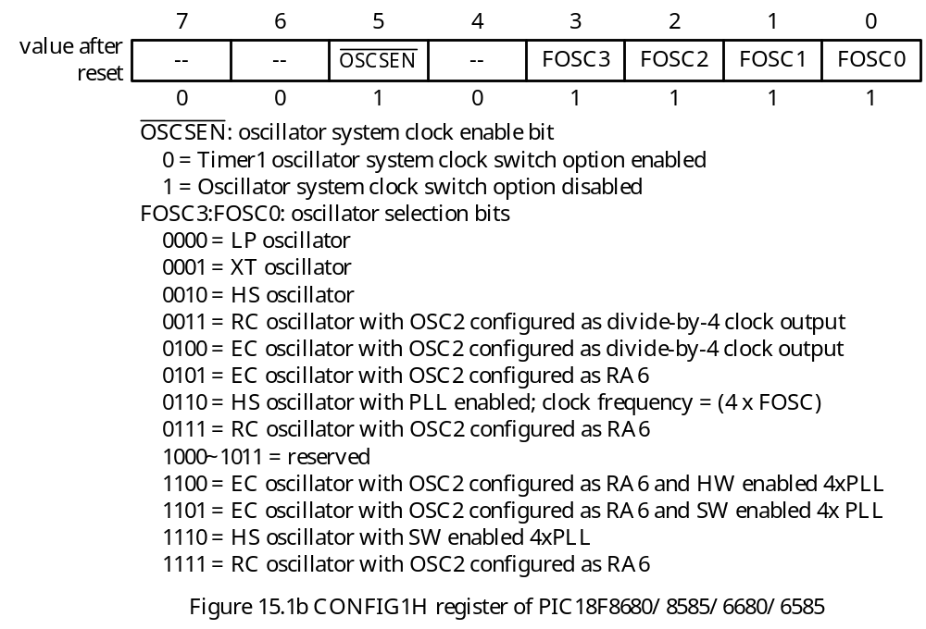

Slide 5
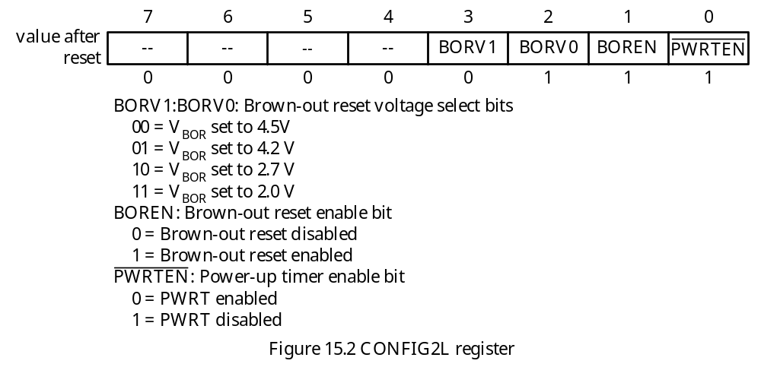
CONFIG2L Register
Select brown-out voltage level, enables/disables brown-out reset, enables/disables power-up timer.
Brown-out is a condition that the power supply drops below its normal operation level.

Slide 6
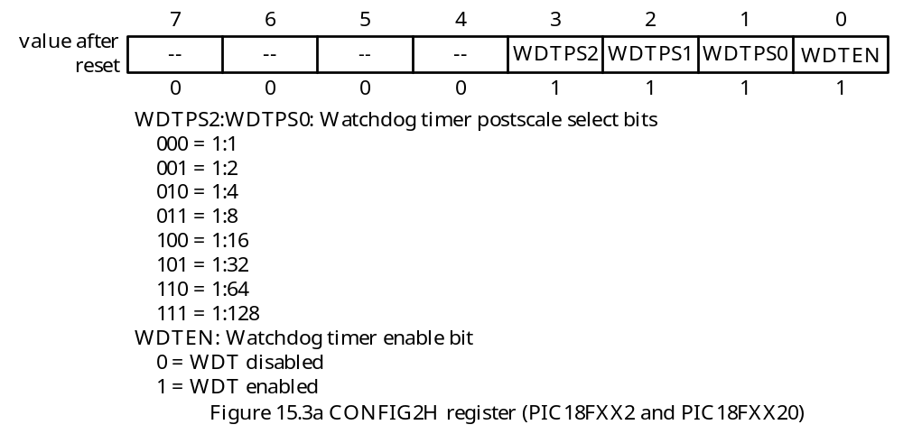
The CONFIG2H Register
Enables/disables the watchdog timer.
Selects appropriate postscale factor.

Slide 7
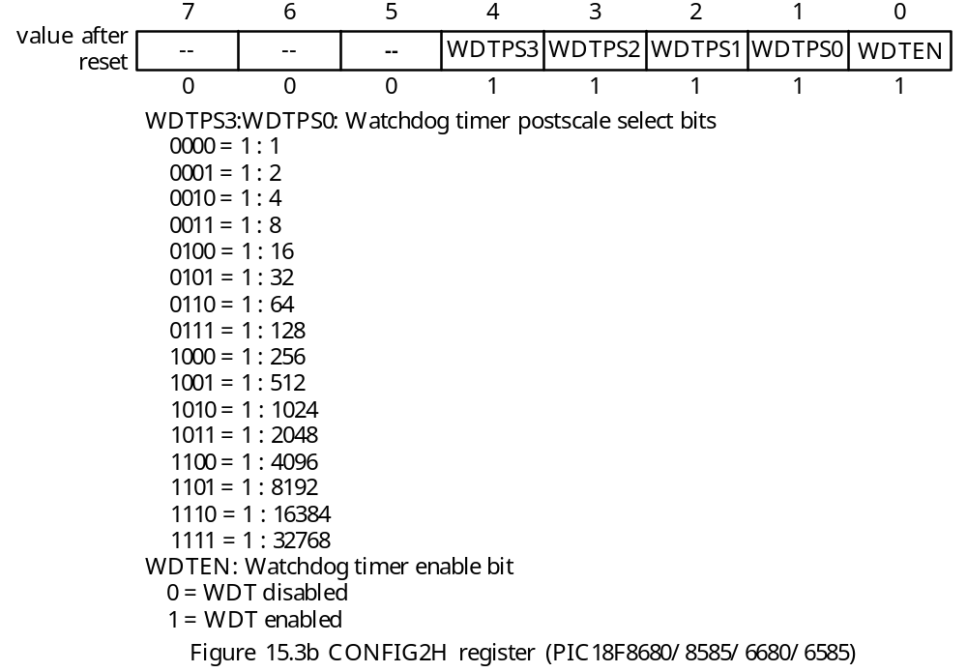

Slide 8
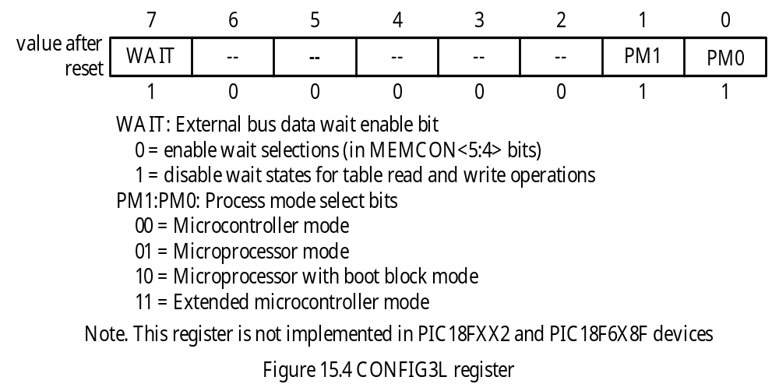
The CONFIG3L Register
- Inserts wait states to the external memory access cycles and also to select the microcontroller operation mode.

Slide 9
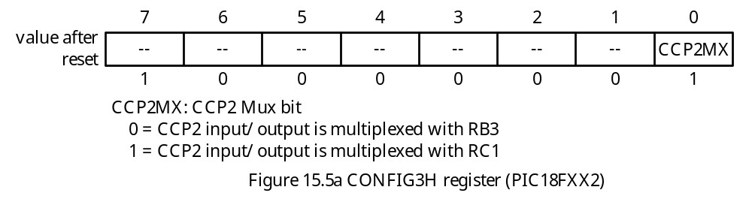
The CONFIG3H Register
Enable MCLR pin
Configure the CCP2 pin multiplexing

Slide 10
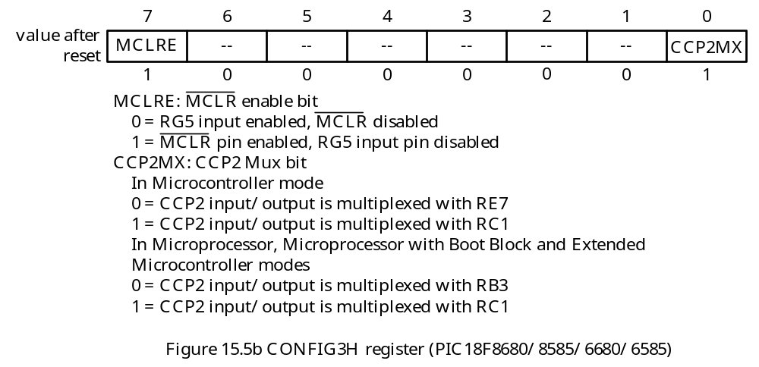

Slide 11
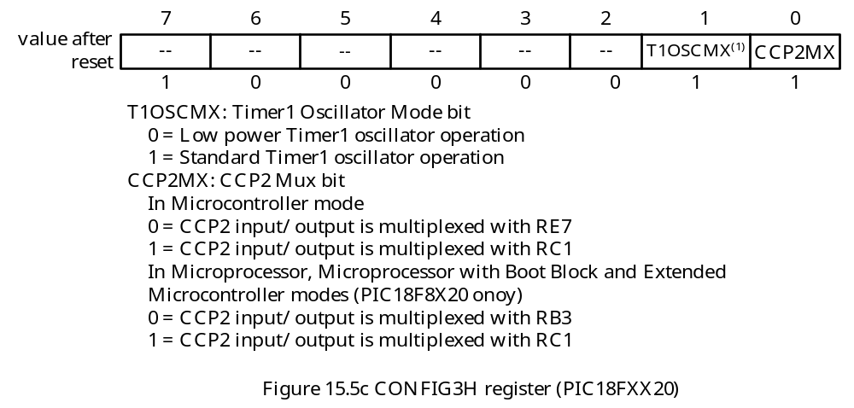

Slide 12
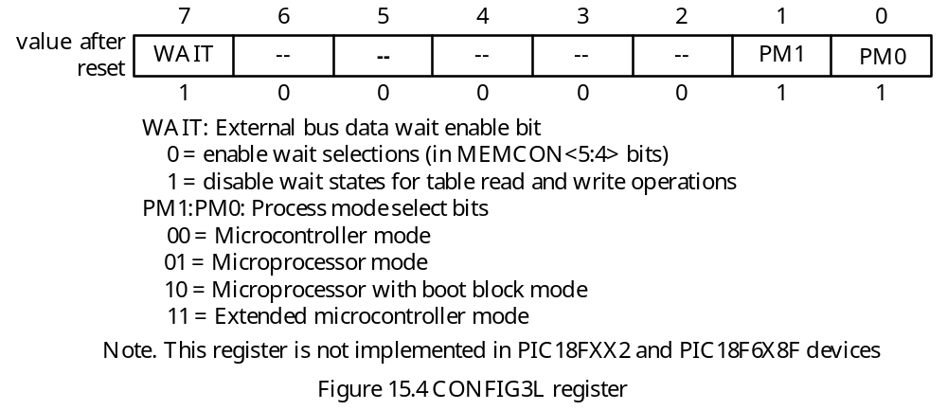
The CONFIG4L Register
Enables/disables background debugger
Enables/disables low-voltage in circuit serial programming (ICSP)
enables/disables return stack overflow reset

Slide 13
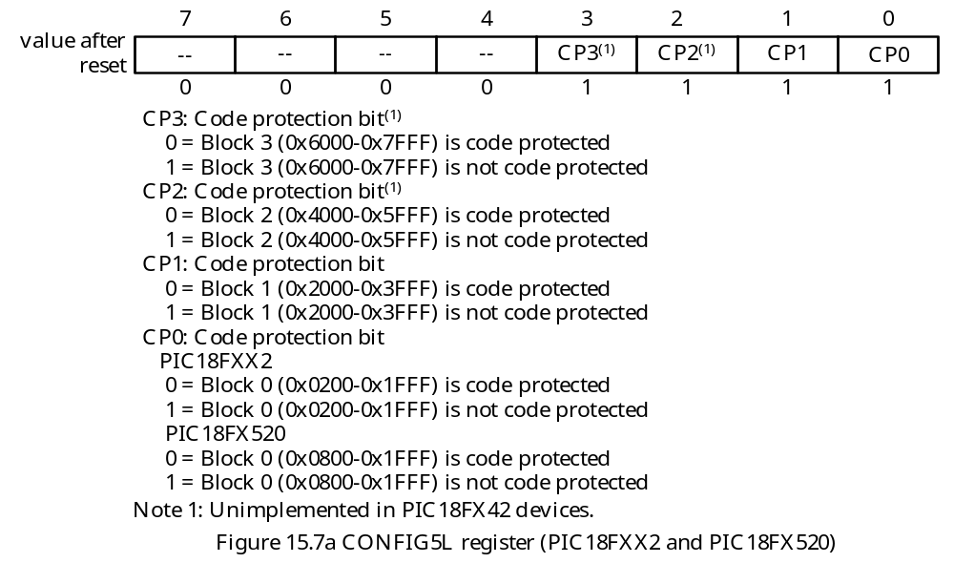
The CONFIG5L Register
- Specify blocks of code to be protected against table-read and table-write from other blocks.

Slide 14
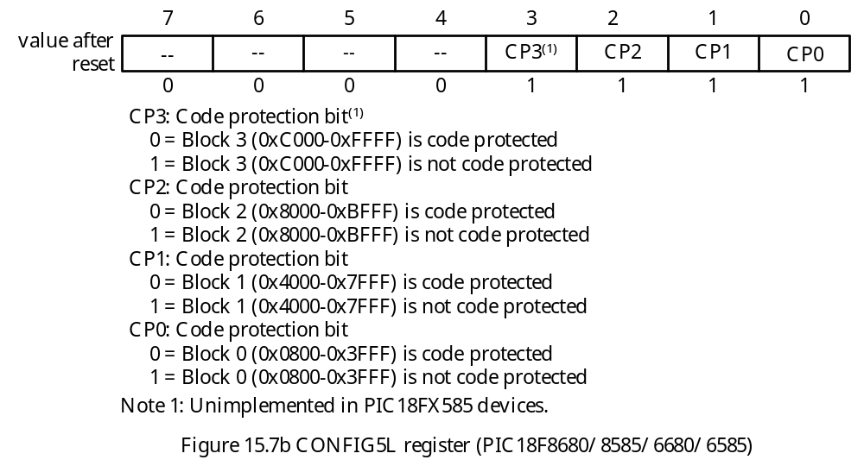

Slide 15
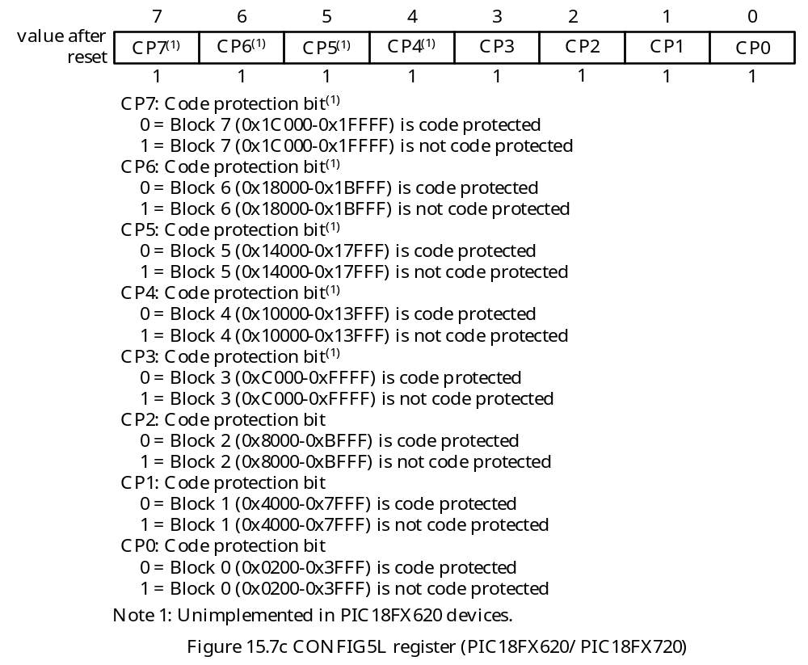

Slide 16
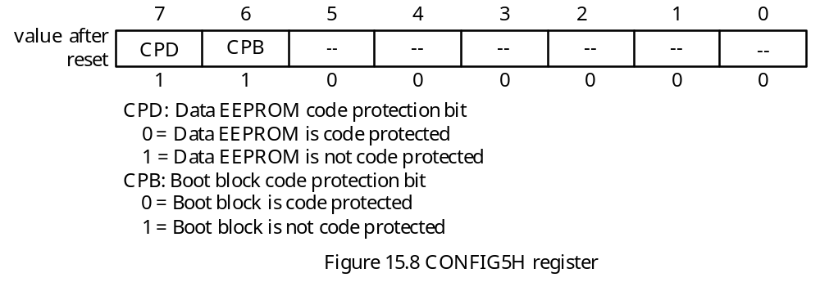
The CONFIG5H Register
- Allow protecting the data EEPROM and boot block.

Slide 17
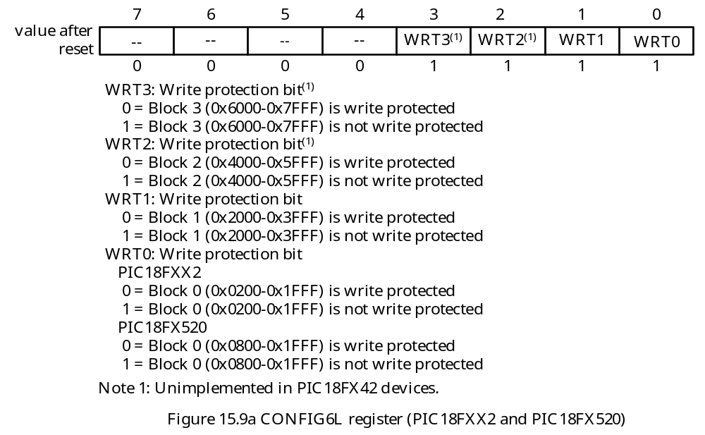
The CONFIG6L Register
- Provide write protection to the program memory.

Slide 18
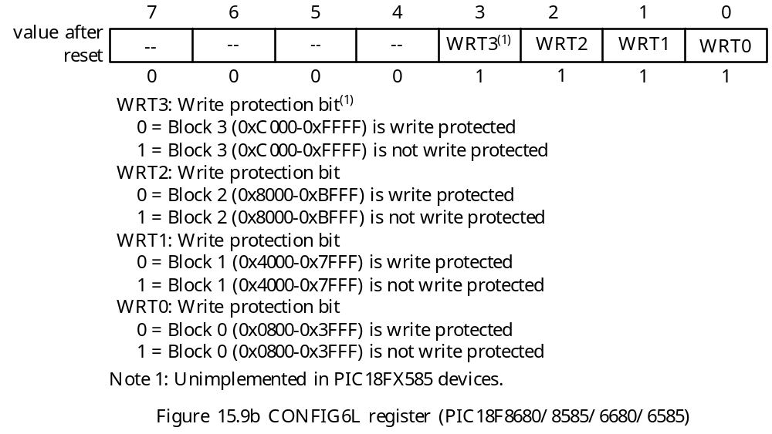

Slide 19


Slide 20
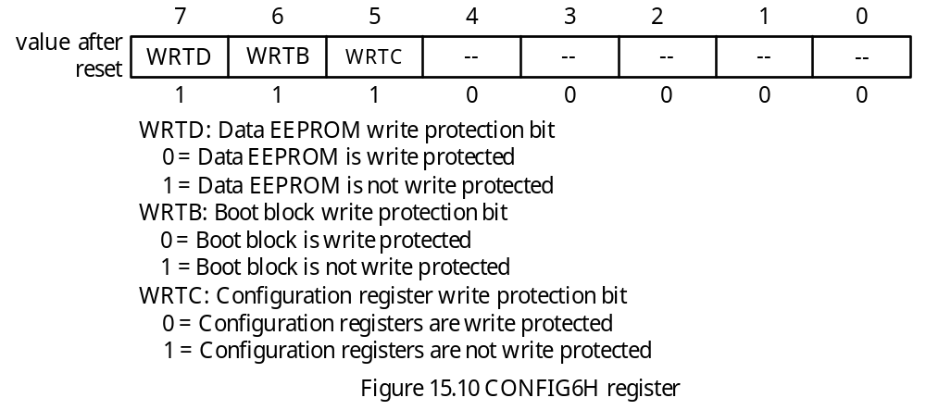
The CONFIG6H Register
- Provides write protection to the data EEPROM, the boot block, and the configuration register write protection bits.

Slide 21
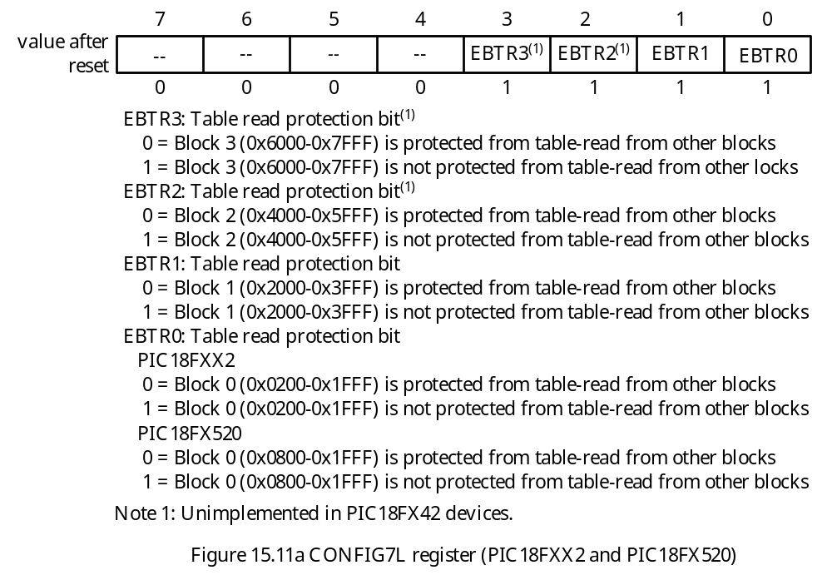
The CONFIG7L Register
- Prevents any code block to be accessed with table-read instruction from another block.

Slide 22
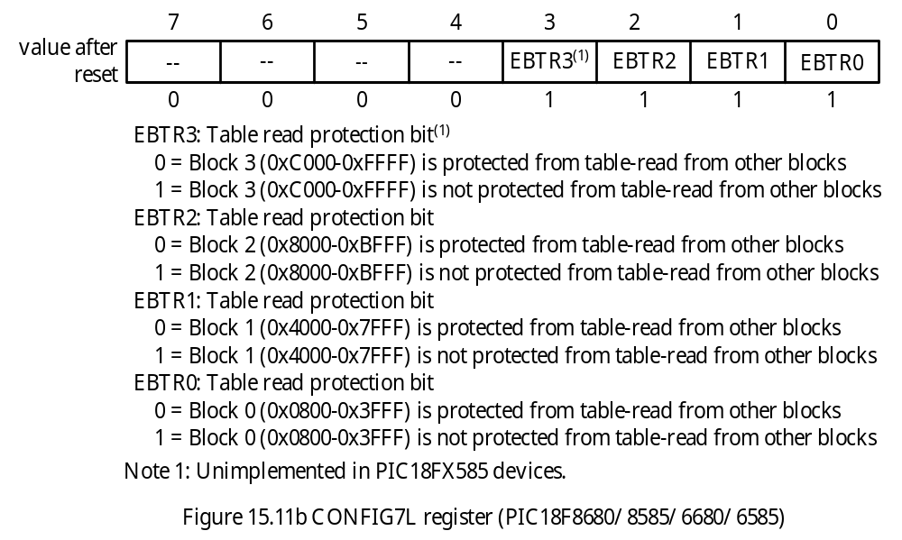

Slide 23
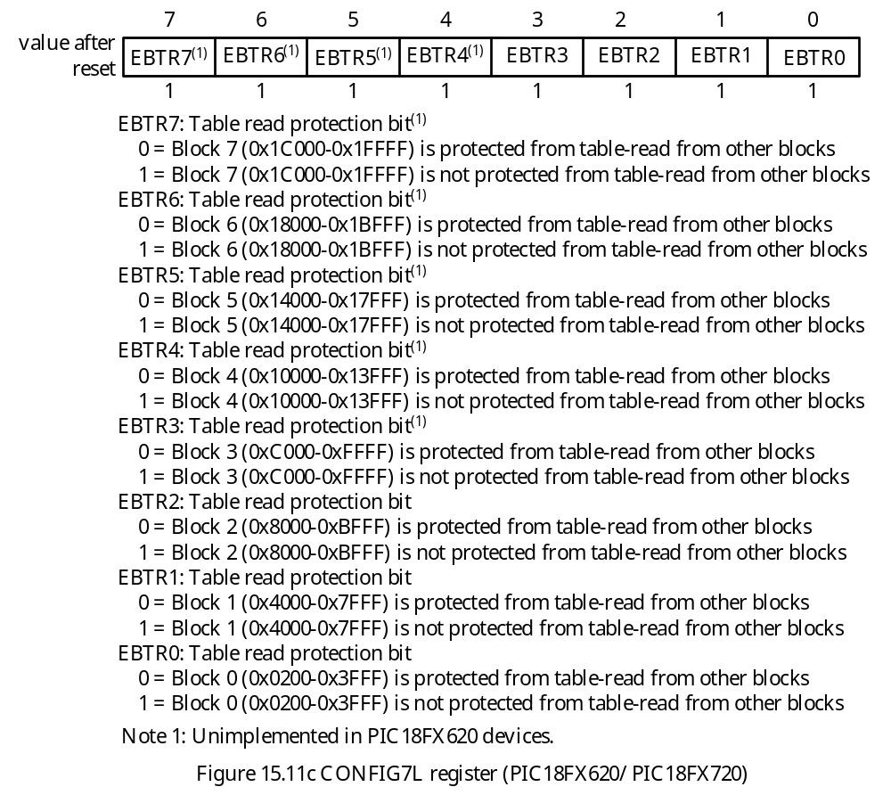

Slide 24
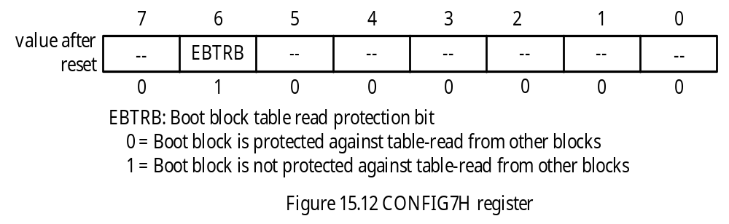
The CONFIG7H Register
- Provides protection against table-read access to the boot block from other block.

Slide 25
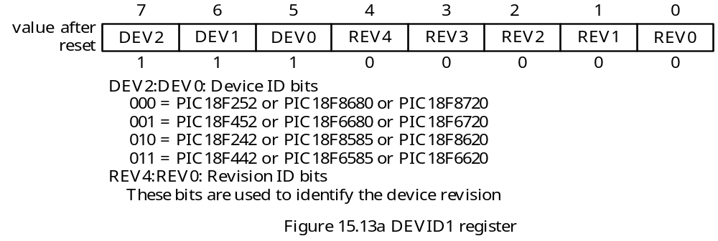
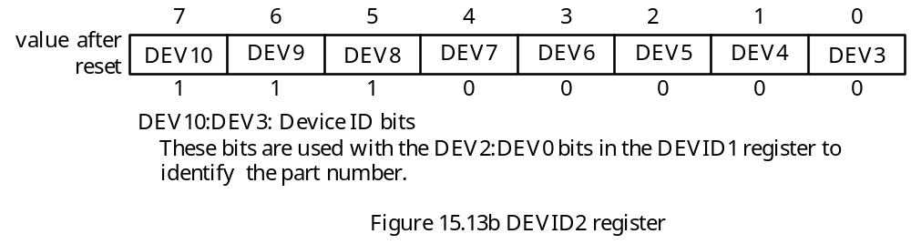
The Device ID Registers
- Identify the microcontroller and its revision number

Slide 26
Programming the Configuration Bits
One can set the configuration bits by using the __CONFIG directive.
The format for using the __CONFIG command is
_ _CONFIG <address>,<expression>
where,
address is the address of the configuration register
expression is the value to be assigned
MPLAB® allows the user to use symbolic name to refer to the address of the configuration register.
_CONFIG1L represents address 0x300001 of CONFIG1L
_CONFIG1H represents address 0x300002 of CONFIG1H
- MPLAB defines the configuration bits in a way to determine the value of the configuration by ANDing the expression

Slide 27
For example,
_EC_OSC_1H equ 0xFC
_OSCS_OFF_1H equ 0xFF
The assembler direction
__CONFIG CONFIG1H, _EC_OSC_1H & _OSCS_OFF_1H
assigns the value 0xFC to the CONFIG1H register
In C language,
The linker file contains a section named CONFIG.
CODEPAGE NAME=config START=0x300000 END= 0x30000D PROTECTED
…
SECTION NAME=CONFIG ROM=config

Slide 28
The #pragma romdat CONFIG directive is used to set the current romdata section to the section named CONFIG.
The configuration for the device can be specified using the _CONFIG_DECL macro and the #defines located in the processor-specific header file.

Slide 29
#include <p18F8680.h>
#pragma romdata CONFIG
_CONFIG_DECL (_OSC_EC_1H, /* Select EC oscillator with OSC2 configured as
divide-by-4 clock output */
_BORV_45_2L, /* enable and set VBOR set to 4.5 V */
_WDT_OFF_2H, /* disable watchdog timer */
_MODE_EM_3L, /* select microcontroller mode */
_MCLRE_ON_3H, /* enable MCLR pin and multiplex CCP2 pin with RC1 */
_LVP_OFF_4L, /* disable low voltage serial programming, disable
background debug mode, enable stack overflow reset */
_CONFIG5L_DEFAULT, /* disable code protection */
_CONFIG5H_DEFAULT, /* disable data EEPROM protection, no boot block
protection */
_CONFIG6L_DEFAULT, /* disable write protection to program memory */
_CONFIG6H_DEFAULT, /* no write protection to data EEPROM, boot block, &
configuration registers */
_CONFIG7L_DEFAULT, /* No read protection to program memory */
_CONFIG7H_DEFAULT /* No table read protection to boot block */
);
#pragma romdata
void main (void)
{
}

Slide 30
Example 15.1 Write a few assembler directives to define the following configurations for the PIC18F8720:
1. Disable oscillator switch for Timer1
2. Select external oscillator with OSC2 pin configured as FOSC/4 output
3. Enable power-up timer
4. Disable brown-out reset
5. Enable watchdog timer and set postscaler to 1:32
6. Let CCP2 pin be multiplexed with the RE7 pin
7. Select microcontroller mode
8. Disable stack overflow reset, disable low-voltage reset, and disable background debugger
9. Disable all protections to the program memory, the data EEPROM, and the boot block
Solution:
__CONFIG _CONFIG1H, _OSCS_OFF_1H & _EC_OSC_1H
__CONFIG _CONFIG2L, _BOR_OFF_2L & _PWRT_ON_2L
__CONFIG _CONFIG2H, _WDT_ON_2H & _WDTPS_32_2H
__CONFIG _CONFIG3L, _MC_MODE_3L
__CONFIG _CONFIG3H, _CCP2MX_OFF_3H
__CONFIG _CONFIG4L, _STVR_OFF_4L & _LVP_OFF_4L & _DEBUG_OFF_4L

Slide 31
Watchdog Timer (WDT)
A circuit that will reset the MCU when it times out.
The execution time of a well-written sequence of instructions, function, or program is predictable.
It is possible to add a few instructions to reset a timer periodically before it overflows (or referred to as times out).
Program bugs may prevent the program from resetting the timer before it times out.
The clock signal to WDT comes from a RC circuit.
The time-out period of the WDT ranges from 7 ms to 33 ms.
The WDT has a postscaler to extend its reset period.
If the MCU is in sleep mode, a WDT time-out causes the MCU to wake up and continue with normal operation.
The PIC18 MCU has a watchdog control register (WDTCON) that allows the user to override the WDT enable configuration bit if the configuration bit disabled the WDT.
The WDTCON register has only the bit 0 (SWDTEN bit) implemented.

Slide 32
Example 15.2 Assume that there is an embedded product designed with a PIC18F8680 and can complete all the processing no more than 800 ms. Suppose the designer wants to detect the software during the development stage and enables the watchdog timer. What is the postscale factor to be set for this application?
Solution:
The smallest postscaler that will cause the WDT to time out in a period larger than 800 ms is 128.
This postscaler will cause the watchdog timer to time out in 896 ms.
To more accurately detect the software bug, the user should add 96 ms unnecessary delay to the application.

Slide 33
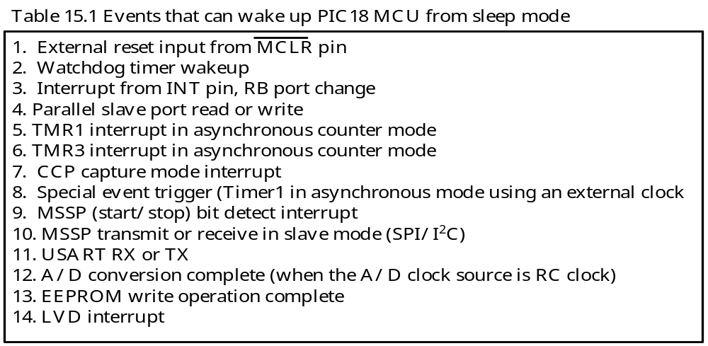
Power-Down Mode (SLEEP)
It is desirable to reduce the power consumption when an embedded product is not being used.
The sleep instruction allows the MCU to enter power down mode.
The system clock stops in power-down mode.
The events that can wake up the MCU from sleep mode are listed in Table 15.1.
MCLR reset will cause a device reset.
All other events wake up the MCU to continue program execution.

Slide 34
Program Code Protection
It is desirable to prevent our competitors from copying our software and even improve from it.
Any prevention to the piracy is to prevent reading or writing the user application from outside the chip.
To prevent piracy, the PIC18 MCU divides the user program memory into blocks on binary boundary.
Each block has three separate code protection bits associated with it:
1. Code protect bit (CPn)
2. Write protect bit (WRTn)
3. External block table read bit (EBTRn)
The code protection bits are located in Configuration Registers 5L through 7H.
The sizes of the blocks to be protected are either 8KB or 16KB.

Slide 35
